Slide 1
BM Project – Human Data Update
Macrophage Sub-clustering Analysis | GSE266330 | 30 samples | 15,074 macrophages
Jianting Sheng | Houston Methodist Neal Cancer Center

Slide 2
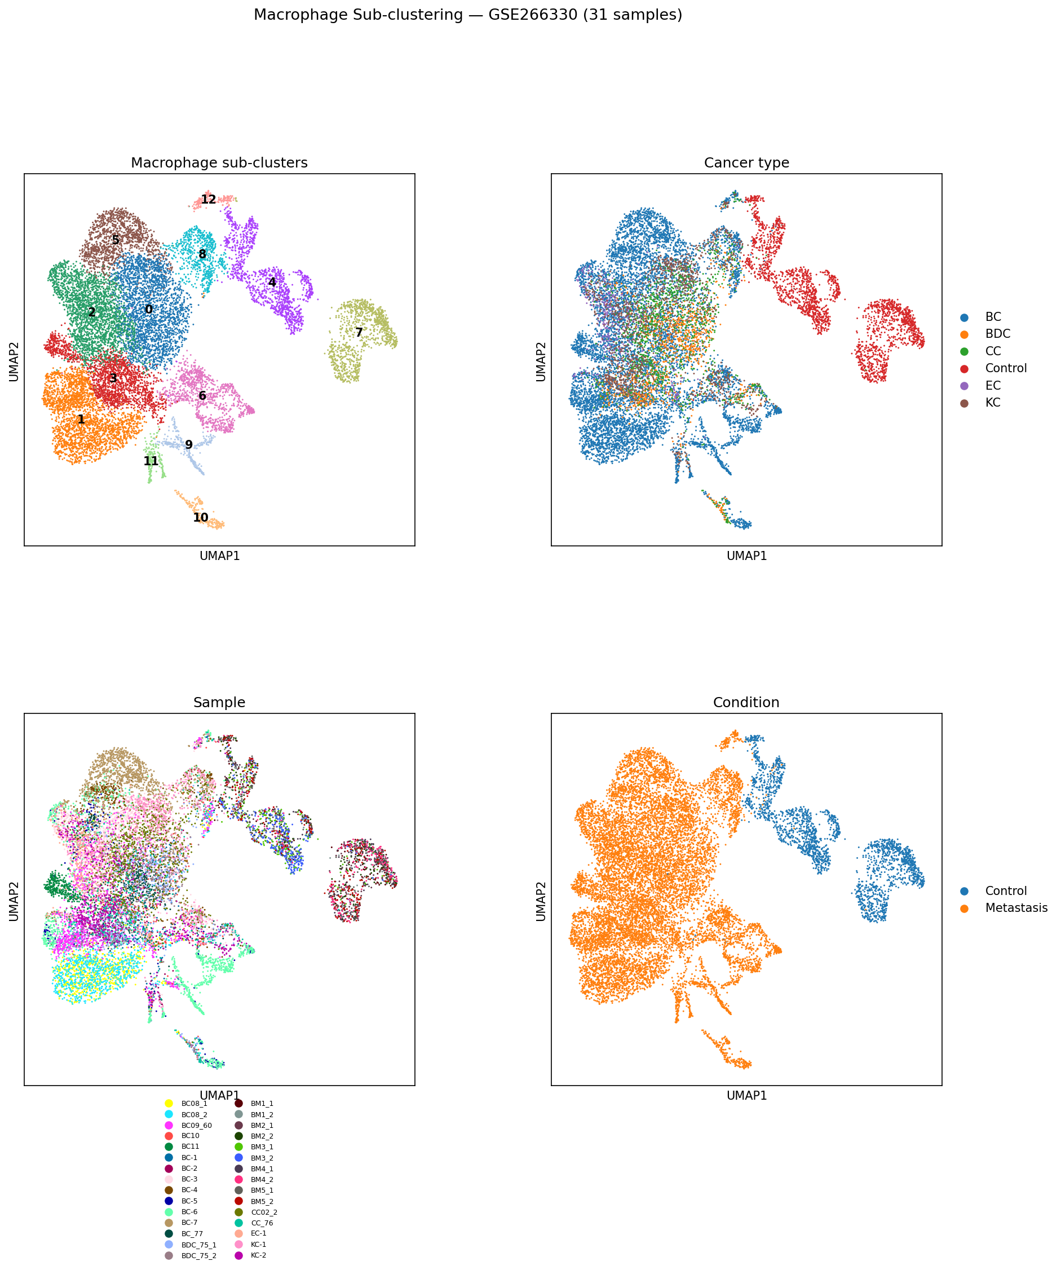
Macrophage Sub-clustering (UMAP)
30 samples pooled → 13 sub-clusters | GSE266330, Liu et al. 2025

Slide 3
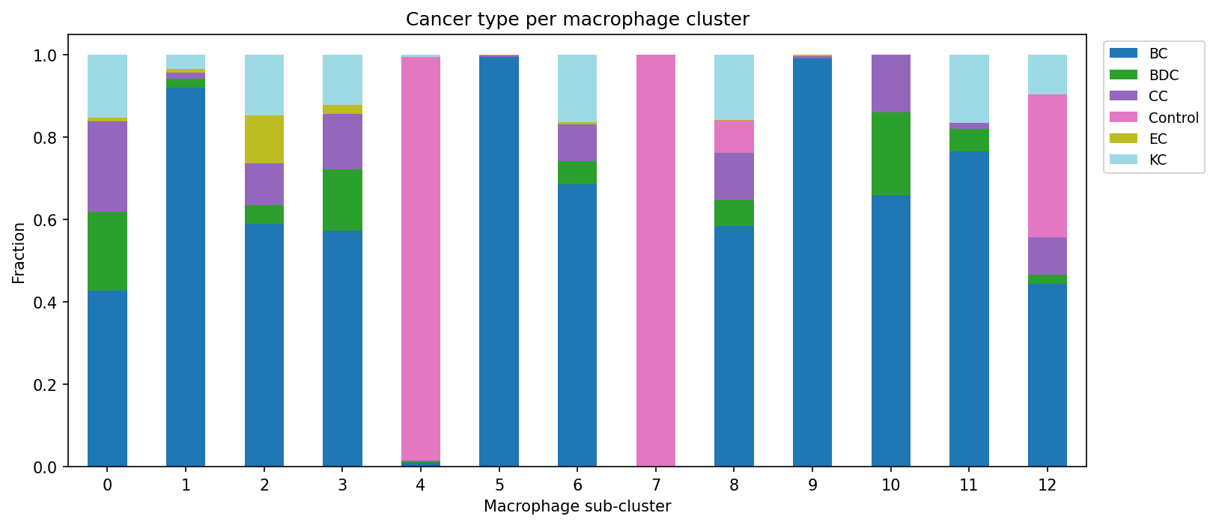
Cancer Type Composition per Macrophage Cluster
BC / BDC / BM / CC / EC / KC samples

Slide 4
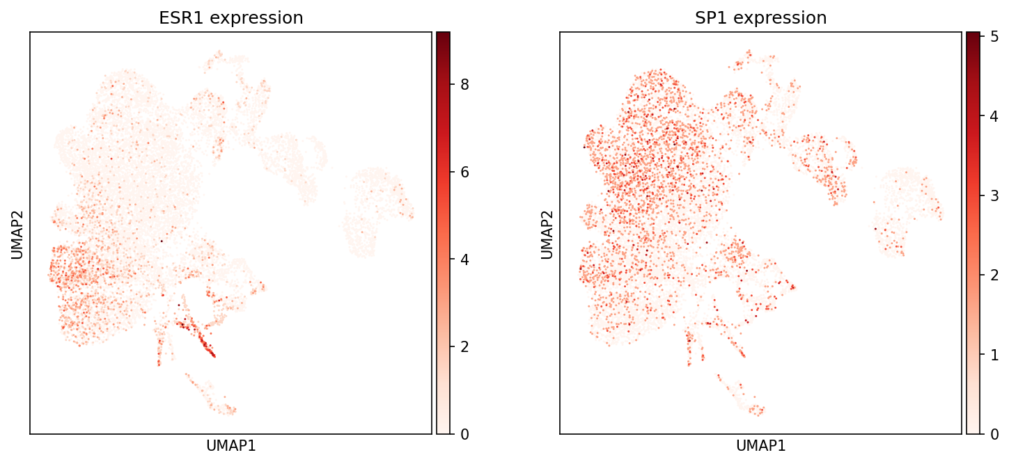
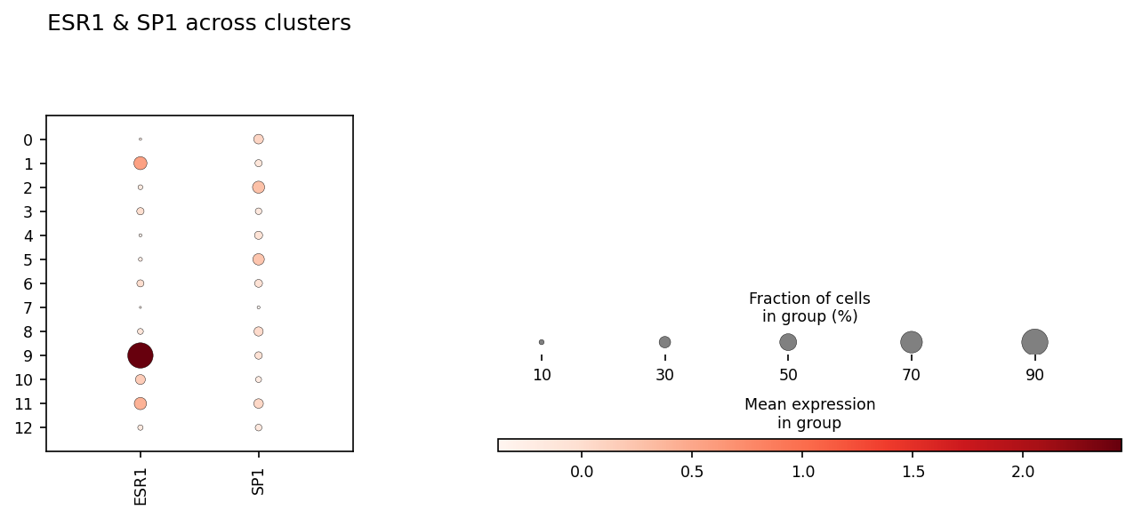
ER / SP1 Co-expression in Macrophage Sub-clusters
Cluster 9 identified as ER+/SP1-high
Key finding
• Cluster 9 = ER+/SP1-high
• Both ESR1 and SP1 expressed
– above background in cluster 9
• Matches Yuliang's gene signature
Next
• Validate with marker genes
• Cross-ref S2C2 crosstalk axis

Slide 5
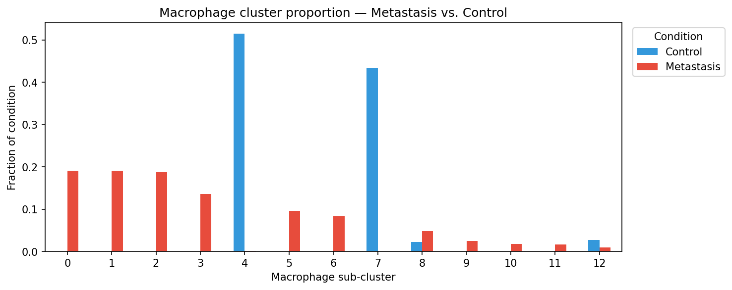
Macrophage Cluster Enrichment — Metastasis vs. Control
Are specific sub-clusters over-represented in metastatic samples?

Slide 6
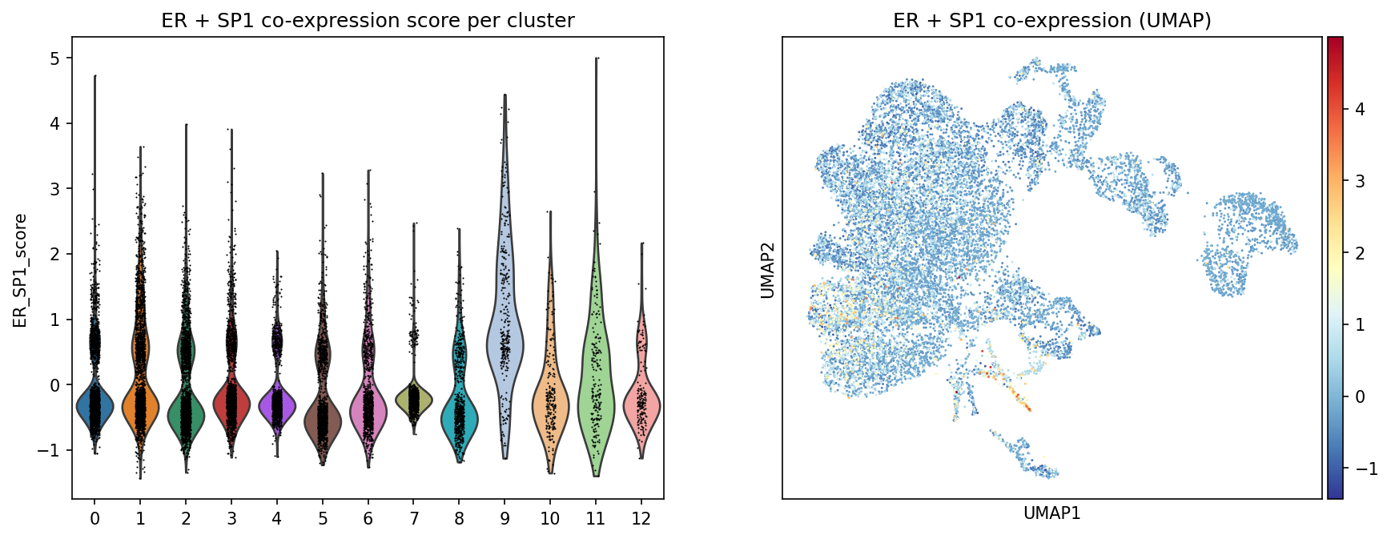
ER + SP1 Co-expression Score — UMAP & Violin
Combined ESR1+SP1 module score; cluster 9 highest mean

Slide 7
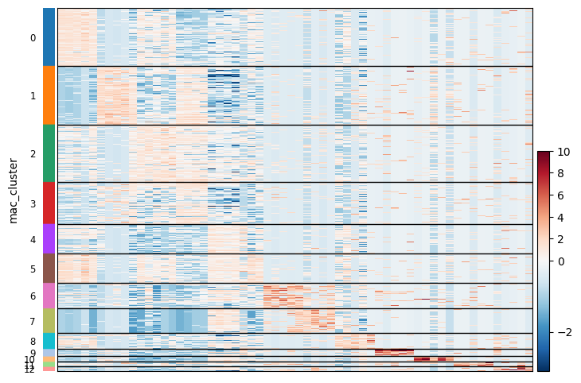
Top DEGs per Macrophage Sub-cluster (Wilcoxon)
Top 4 marker genes per cluster

Slide 8
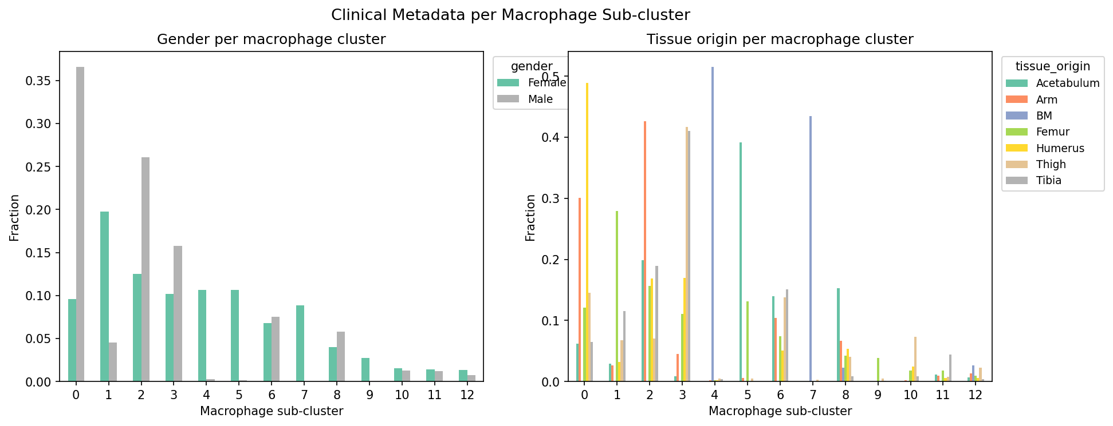
Gender & Tissue Origin per Macrophage Cluster

Slide 9
Summary & Next Steps
Results
• 13 macrophage sub-clusters identified
– from 15,074 macrophages, 30 samples
• Cluster 9 = ER+/SP1-high
– highest combined ESR1+SP1 score
• BC samples dominant in cluster 9
– consistent with ER+ breast cancer biology
• Gender + tissue origin breakdown shown
Next steps
• Annotate clusters with canonical markers
– Cross-ref Yuliang's gene signature
• Link cluster 9 to S2C2 crosstalk model
– ER+ Mφ → CD8+ T cell axis
• Validate in mouse scRNA (Jianting W2/W3)
• Drug target screen on cluster 9
• Obtain remaining 32 samples (LC/PC/RC/TC)
– pending storage quota expansion

